Slide 1
Foundations of a Healthy Relationship
Chap 6 Lesson 1

Slide 2
Relationships in Your Life
Define Relationship: a bond or connection you have with other people
Different types of relationships
1. Family
2. Friends
3. Community
4. Dating/Romantic
Define friendship: a significant relationship between two people that is based on trust, caring, and consideration
Define citizenship: the way you conduct yourself as a member of the community
Define role: a part you play in your relationships

Slide 3
Relationships in Your Life
Traits of a healthy relationship
1. Mutual respect
2. Caring
3. Honesty
4. commitment
Three skills that help build healthy relationships
1. communication
2. cooperation
3. compromise
Define cooperation: working together for the good of all
Define compromise: a problem-solving method in which each participant gives up something to reach a solution that satisfies everyone.

Slide 4
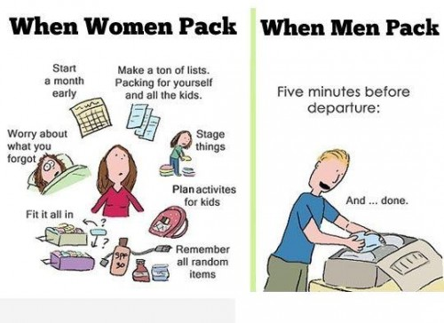
Male and Female Differences

Slide 5
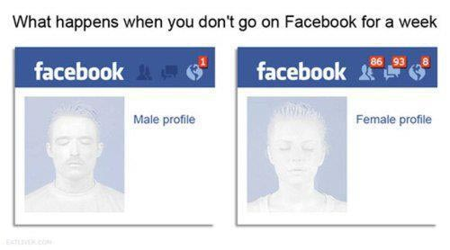

Slide 6
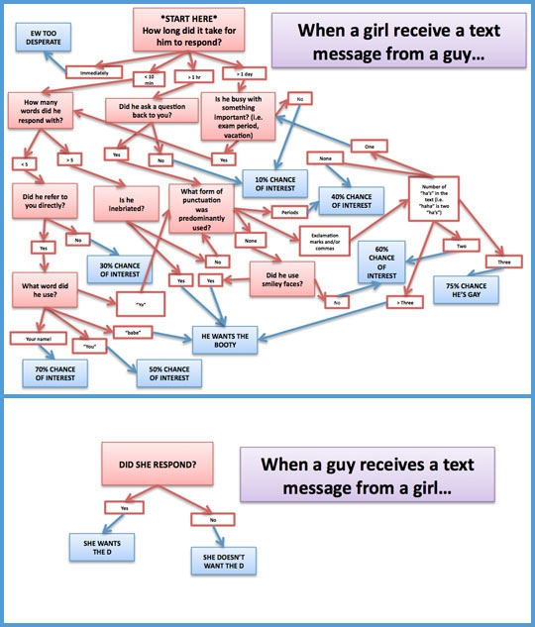
Notes:
After slides show video clips:
https://www.youtube.com/watch?v=-4EDhdAHrOg all about the nail
https://www.youtube.com/watch?v=7hFAv8z8xmw Phil, modern family

