Slide 1
Drug Classifications, Tobacco, and Alcohol

Slide 2
Classification of Drugs | Examples | How it affects the body
Depressants | Alcohol, valium, Xanax | Slows normal brain function. High addictive potential Withdrawal effects from long-term use can be life-threatening and produce some of the worst consequences of any other drug classifications
Stimulants | Cocaine, methamphetamine, amphetamine, MDMA (ecstasy), nicotine, and caffeine. | Elevates mood Increases feelings of well-being Increases energy and alertness Faster heart rate Increases blood pressure Very high addictive potential
Opiates (powerful painkillers) | Heroin, morphine, codeine, and Oxycontin | Produces a quick, intense feeling of pleasure followed by a sense of well-being and calm Very high addictive potential
Hallucinogens | LSD, PCP, MDMA (Ecstasy), marijuana, mescaline, and psilocybin. | Altered perception and feeling Powerful mind-altering effects Affects regions of the brain that are responsible for coordination, thought processes, hearing, and sight. People to hear voices, see things, and feel sensations that do not exist. Moderate potential for addiction High potential for tolerance
Notes:
Videos: http://www.methproject.org/answers/will-using-meth-change-how-i-look.html#Looks-Horrible
http://www.methproject.org/answers/will-using-meth-change-how-i-look.html#Mug-Shot-Match-Up
http://www.drugfreeworld.org/real-life-stories/painkillers.html

Slide 3
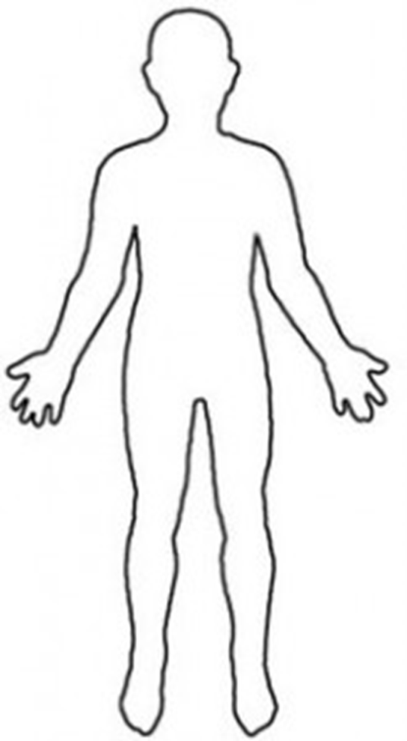
Pre-Test: You have 3 minutes Label the parts of the body that are affected by smoking cigarettes and explain what happens to that part of the body before the lecture.
The brain: Changes in brain chemistry

Slide 4
Vocabulary
Nicotine: the addictive drug found in tobacco leaves.
Stimulant: a drug that increases the action of the central nervous system, the heart, and other organs.
Carcinogen: a cancer-causing substance
Tar: a thick, sticky, dark fluid produced when tobacco burns.
Carbon Monoxide: a colorless, odorless, and poisonous gas
Smokeless Tobacco: tobacco that is sniffed through the nose, held on the mouth, or chewed.
Leukoplakia: thickened, white, leathery-looking spots on the inside of the mouth that can develop into oral cancer.
Notes:
http://www.cnn.com/2013/10/31/health/smoking-aging-identical-twins/index.html?iref=allsearch
https://www.youtube.com/watch?v=ixMEEI0Zq9g
https://www.youtube.com/watch?v=WnqZoKZuHCg

Slide 5
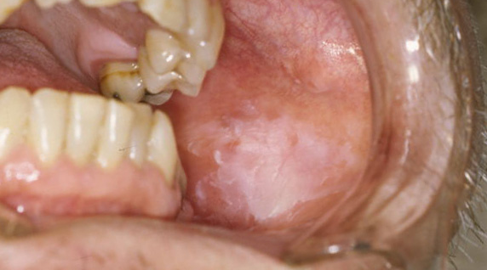
Leukoplakia

Slide 6
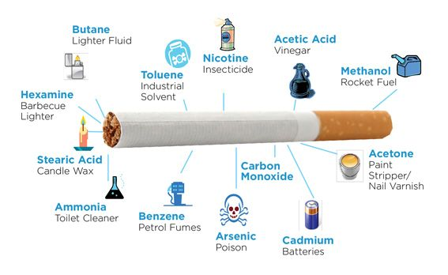
What’s in a cigarette?

Slide 7
Short Term Effects of Tobacco Use
Brain chemistry changes, causes body to crave the drug
Respiration and heart rate increases
Taste buds are dulled and appetite is reduced
Users have bad breath, yellow teeth, and smelly hair, skin, and clothes.

Slide 8
Long Term Effects of Tobacco Use
Chronic bronchitis: occurs when the cilia in the bronchi become so damaged that they are useless. Leads to build up of tar in the lungs.
Emphysema: is a disease that destroys the tiny air sacs in the lungs, making them less elastic, causing it difficult for the lungs to absorb oxygen.
Lung cancer: nearly 90 percent of lung cancer deaths are caused by smoking
Coronary heart disease and stroke
A weakened immune system

Slide 9
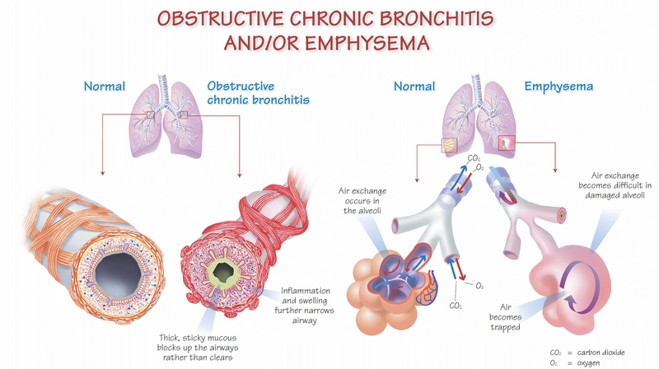

Slide 10
The Cost of Smoking
Tobacco is an expensive habit that takes years off a person’s life. To learn more, answer each question below. Feel free to use a calculator for the problems with large numbers.
These days, cigarette prices are going up all the time. For this activity, we’ll use the average price of $5.36 per pack. Answer in complete sentences.
If someone smoked a pack of cigarettes a day, how much money would that person spend in a week?
How much would that person spend in a 30-day month? In 1 year? 7 years?
By being a non-smoker over the next 60 years, how much money could you save?
List five things you could buy with the answer you got for #3.
On average, each cigarette a person smokes takes 8 minutes off that person’ life span. If someone smokes 20 cigarettes per day for 35 years, how much will smoking shorten the person’s life? (round to the nearest year).
List 5 things you can do in 8 minutes or less.

Slide 11
Write an editorial
Write an editorial for a newspaper that encourages people to quit using tobacco products, and explain the short and long-term effects of tobacco use on ones body. Your editorial must be at least 2 paragraphs and have at least 5 sentences in each paragraph. Students will present their editorials.

Slide 12
Post-Test: You have 5 minutes Label the parts of the body that are affected by smoking cigarettes and explain what happens to that part of the body AFTER the lecture.
The brain: Changes in brain chemistry

