Slide 1
Disease
Noncommunicable Disease:
A disease that is not transmitted by another person, a vector, or the environment
Ex. Cancer, Cardiovascular disease, Diabetes, Chronic Respiratory Diseases (Ex. Asthma, emphysema, chronic bronchitis)
Communicable Disease
A disease that is spread from one living organism to another or through the environment
Ex. Flu, common cold, pneumonia, STDs
Infection
A condition that occurs when pathogens in the body multiply and damage body cells
Notes:
What do you think are the top four NCDs worldwide?
NCDs:
https://www.youtube.com/watch?v=4nHMV_420zg
Predisposition to these diseases + environmental factors
Obesity, alcohol and tobacco

Slide 2
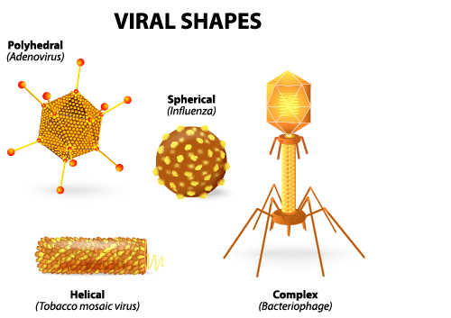
Pathogen
A microorganism that causes disease
Every communicable disease can be traced to a particular pathogen
Virus
A piece of genetic material surrounded by protein coat
Non-living
No cure
The common cold, influenza, viral pneumonia

Slide 3
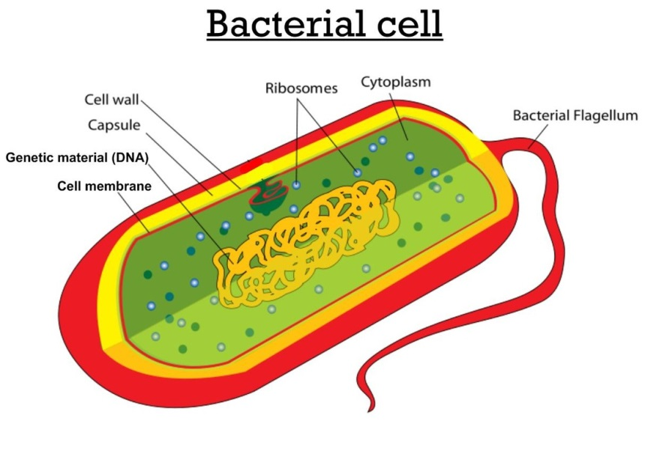
Bacteria
Single-celled microorganism
Can be treated with antibiotics
Strep throat, tuberculosis, bacterial pink eye,
and bacterial pneumonia
Protozoas
Single-celled microorganisms that are larger and more complex than bacteria
Ex. Malaria: an intermittent and remittent fever caused by a protozoan parasite that invades the red blood cells. The parasite is transmitted by mosquitoes in many tropical and subtropical regions
Notes:
Complete STD activity before talking about STDs
Cards, get three signatures
Ask questions: What actions/situations would continue the spread of communicable diseases, specifically STD’s? What actions could stop the spread of communicable diseases, specifically STD’s?

Slide 4
Sexually Transmitted Diseases
Students will analyze the impact of STDs including HIV and AIDS on self and others

Slide 5
Vocabulary
Sexually Transmitted Diseases (STDs)
Contagious diseases spread from person to person through sexual behaviors.
Sexually Transmitted Infections
STD’s are also known as this

Slide 6
Vocabulary
Asymptomatic
individuals show no symptoms, or the symptoms are mild and disappear after the onset of the infection
Antibiotics
a class of chemical agents that destroy disease causing microorganisms while leaving the patient unharmed

Slide 7
Vocabulary
HPV Vaccine
a vaccine that can prevent cervical cancer, pre-cancerous genital lesions (or sores), and genital warts caused by genital HPV infection.
Abstinence
Deliberate or voluntary decision to refrain from behaviors such as sexual activity or the use of alcohol, tobacco and other drugs.
Pelvic Inflammatory Disease (PID)
infection of the uterus, fallopian tubes, and other reproductive organs that causes symptoms of lower abdominal pain. A complication of some . STDs especially gonorrhea and chlamydia

Slide 8
Vaccine Review
Vaccines contain parts of the bacteria or virus OR whole bacterium and virus that have been killed or weakened so it cannot cause disease.
The body recognizes these as antigens, stimulating the immune system to make antibodies to attack and kill antigen.
Memory cells are then created and if the same antigen enters the body again, these memory cells remember how to fight them and will prevent reinfection.
Immunity occurs

Slide 9
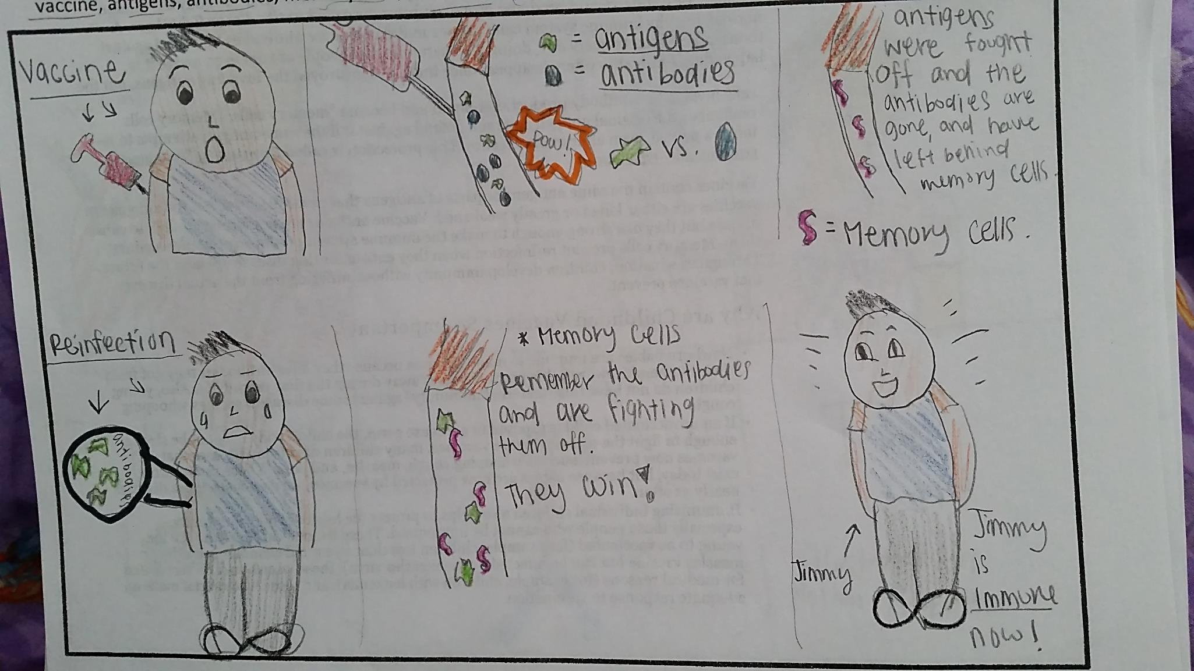

Slide 10
Statistics
One in five people in the United States has an STD.
The Center for Disease control estimates that direct medical costs connected to STDs are now more than $15.3 billion a year.
It is estimated that 9 million young people ages 15 and 24 will become infected with an STD each year.
Untreated syphilis in pregnant women results in infant death in up to 40 percent of cases.
Each year, untreated STDs cause infertility in at least 24,000 women in the US

Slide 11
STD | Pathogen | Symptoms | Can it be cured? | Dangers
Genital Warts | Human Papillomavirus | Warts on genitals | NO but it can be treated to reduce symptoms. | Cervical Cancer for women
Chlamydia | Bacteria | Genital burning/itching, unusual discharge | YES with antibiotics | Inflammation of urethra; infertility
Genital Herpes | Herpes Simplex II Virus | Blisters on genitals | NO but it can be treated to reduce symptoms. | Life threatening infection for newborns
Gonorrhea | Bacteria | Pelvic pain/burning sensation when urinating | YES with antibiotics | Infertility in males and females
Trichomoniasis | Protozoan | Thick grey/yellowish green discharge | YES with metronidazole | Higher susceptibility to other STD’s
Syphllis | Spirochete (bacteria) | A single sore on genitals | YES with penicillin or other antibiotics | Damage to internal organs, brain, heart
HIV/AIDS | Virus | Generalized symptoms like fevers, fatigue, weight loss, weakness in limbs | NO but can be treated with antiretroviral medication (slows virus) | Weakened immune system; death

Slide 12
Review
Pathogen: Bacteria or protozoan/Curable | Pathogen: Virus/ incurable
Chlamydia | HIV/AIDS
Gonorrhea | Genital Herpes
Syphilis | Genital Warts (HPV)
Trichomoniasis

Slide 13
HIV/AIDS
HIV: Human Immunodeficiency Virus
AIDS: Acquired Immunodeficiency Syndrome

Slide 14
How is HIV spread?
Sex
Sharing needles
Mother to baby
Virus is too fragile to live outside of a host. It will die at room temperature and cannot be spread through the air.

Slide 15
Once HIV is in the body, it attacks the body’s immune system
It enters certain cells, replicates itself (mutated copies of self), and eventually destroys the cell

Slide 16
Stage 1: Asymptomatic
Can lasts for 10 years or more
Stays within the lymph nodes where it takes over the helper T cells
No outward signs of infections
*T cells communicate to B cells to create antibodies . B cells then develop into memory cells.

Slide 17
Stage 2: Middle
Occurs in about 40% to 70% of infected patients
Symptoms includes flu-like symptoms (headaches, fever, sore throat, rash, diarrhea and enlarged lymph nodes)

Slide 18
Stage 3: Symptomatic
Helper T cells fall to 200-400 per milliliter of blood
Patient experiences flu-like symptoms such as headaches, fever, body aches, diminished appetite, swollen glands, weight loss and skin rashes.

Slide 19
Stage 4: AIDS
Helper T cells drop to less than 200 per milliliter of blood
One or more AIDS-opportunistic illnesses are present
Pneumonia, TB, Kaposi's sarcoma

Slide 20
Treatment
Antiretrovial medication (the triple cocktail)
Problems with treatment
Expensive
Toxic
Severe side effects

Slide 21
Prevention Measures
Sexual Abstinence
Do not share needles
Avoid situations that involve drugs/alcohol
Use refusal skills when feel pressured

