Slide 1
4 Stages of Addiction
1) Experimenter – curiosity is a motivator; “high” is a new feeling; learning to trust/mistrust the drug; can still relate to people

Slide 2
4 Stages of Addiction
2) Regular User – seeks the “high;” comfort & confidence in using; peer group uses; getting “high” is important; tolerance develops; cocky; has problems relating with people.

Slide 3
4 Stages of Addiction
3) Preoccupied User – thinking more about drugs; wants to be “high” often; blackouts start; relationships are difficult; clearly wants to use the drugs; uses when alone; still thinks he/she is in control.

Slide 4
4 Stages of Addiction
4) Addict – must take drug to survive; no choice must use; relates to drugs, not people; will use any time; obnoxious, intimidating; drugs are their life
Teens – these steps can happen in as little as 6-18 months due to the still-developing nature of the teen bodies

Slide 5
Downhill Slide Activity
3 pieces PURPLE paper – write names of 3 people that you like a lot
3 pieces PINK paper – write 3 things or possessions you regard as special
3 pieces YELLOW paper – write 3 activities you enjoy participating in
3 pieces BLUE paper – write 3 personal attributes, abilities, talents, or characteristics you possess
Notes:
http://www.pkwy.k12.mo.us/homepage/toleary/file/Substance_Abuse_Prevention/Drug_Intro_Alcohol.pdf
Scenario 1: You have been invited to a party. You come home late after curfew, smelling of alcohol. Your parents are waiting up for you. You’re in big trouble! One of your possessions is taken away as a punishment. You must choose which one. Choose one of your possession papers and tear it up. (Give participants about 20 seconds to choose which possession to tear up)
Scenario 2: After a Friday night football game you and a friend go to a mutual friend’s house. His/her parents are not home and there is beer available. You decide to drink quite a bit. The next morning you have a hangover and are not able to participate in one of your favorite activities. Tear up one activity papers and one personal attribute papers. (Give the students 15 seconds to choose which activity and personal attribute up.)
Scenario 3: Drinking has become one of your favorite things to do. You are now looking forward to drinking every weekend. You feel you can handle it – it’s not a problem. Tear up one person paper and one personal attribute. (Give participants 10 seconds to choose which person & personal attribute to tear up)
Scenario 4: You now find yourself drinking daily with serious consequences: suspended from school, stealing money, fighting w/ your parents. Tear up 1 person paper & 1 personal attribute paper. (Give participants 10 seconds to choose which person & personal attribute to tear up)
Scenario 5: On your way home from a weekend of partying, you are picked up for a DUI. Tear up 1 possession square & 1 activity square. (Give 5 seconds to choose)
Scenario 6: You are now totally at the mercy of your addiction. Your life is out of control due to your alcohol use. Ask the participants to hold the remaining 3 pieces of paper in their hand like they would hold a hand of playing cards. Have the participants turn and face their partner with their papers held so that their partner can’t read what is written on the pieces of paper. Have each partner reach across & at random choose 2 pieces of paper from the other person’s hand & tear them up. Each person will now be left with just one piece of paper.

Slide 6
Debrief
Describe your new self to your group members.
From which of the four categories was it most difficult to choose which square to tear up? Why?
How did the shortening of time you had to choose which card to tear up impact your decision?
How does this activity show the loss of control an addicted person experiences? How does it show the consequences?
If we know someone who is becoming or is already addicted, how can we best help them?
Notes:
Have students get into groups when done to discuss these questions. Then ask the whole class some of these questions.

Slide 7
Group/Partner Discussion: Questions to answer
What are the different types of drugs being used by young people today?
Why do you think young people start using drugs?
Where do you think young people get drugs?
What do young people generally think of people who use drugs?
What can drugs do to you:
Physically?
Mentally/emotionally?
Socially?
Economically?
Notes:
Students are still in their groups. Each of them will out a sheet pf paper, discuss these questions and answer the following them. Discuss as a class. Then have students move their chairs back into rows.

Slide 8
Class Discussion on Group Answers

Slide 9
Objective
Students will know the difference between drug abuse and addiction and be familiar with risk and protective factors of drug abuse and addiction

Slide 10
The Role of medicines
Chap 19 Lesson 1

Slide 11
Vocabulary
Define medicines
Drugs that are used to treat or prevent diseases or other conditions
Define drugs
Substances other than food that change the structure or function of the body or mind
Why are all medicines drugs but not all drugs are medicines?
All medicines are drugs because they can change the structure or function of the body or mind to help treat or prevent diseases or other conditions.
All drugs are not medicines because some drugs do not treat or prevent diseases.

Slide 12
Medicines enter the body in a variety of ways
Oral medicines
taken by mouth in the form of tablets, capsules or liquids
can pass from the digestive system into the blood stream
Topical Medicines
applied to the skin
Transdermal skin patches also deliver a medicine through the skin
Inhaled Medicine
delivered in a fine mist or powder (ex. asthma medicine)
Injected medicine
delivered through a shot and go directly into the blood stream
*However you take medicine, it is always important to follow the directions on the medicine label

Slide 13
Quick Review Continued
What type of interaction occurs when medicines work together in a positive way?
Additive Interaction
Example: aspirin + acetaminophen =total effect of both (pain killer) (pain killer) pain killing drugs
What type of interaction occurs when the effect of one medicine is cancelled or reduced when taken with another medicine?
Antagonistic Interaction
Example: Caffeine + alcohol
(stimulant) (depressant)
What is it called when the reaction of two or more medicines results in a greater effect than when each medicine is taken alone?
Synergistic Effect
Example: Alcohol + Sleeping Pills
(depressant) (depressant) = Effects drastically increased!
IT IS EXTREMELY DANGEROUS TO MIX DRUGS!!!

Slide 14
Tolerance vs Withdrawal
What is Tolerance?
a condition in which the body becomes used to the effect of a medicine so the body requires increasingly larger doses to produce the same effect.
What is Withdrawal?
occurs when a person stops using a medicine on which he or she has become physiologically dependent.
Symptoms can include severe headaches, vomiting, chills, and insomnia which gradually ease over time.

Slide 15
Article: Understanding Drug Abuse and Addiction
Read the article then answers the questions on the back of your handout

Slide 16
“Understanding Drug abuse and Addiction” article
Why is quitting so difficult even for those who are ready to do so?
Complex disease. Also drugs change the brain in ways that encourages drug abuse
How does self-control relate to drug addiction?
Self control is lost
What is the best way to help people overcome addiction? Why?
Best way to help people overcome addiction is treatment medication with behavioral therapy because it can be tailored to each individuals needs.
True or False: After treatment, it is uncommon for someone to relapse
False. Relapse is common.
Which drug causes the release of large amounts of dopamine?
A) heroin
B) cocaine
C) marijuana
D) glutamate
E) alcohol
How does dopamine urge an addicted person to continue to abuse drugs?
Cocaine (teaches people to repeat the rewarding behavior of abusing drugs)…leads to lessening of dopamine…leads to abuser’s ability to no longer enjoy the drug or other events that brought them pleasure or joy before. Because of this, tolerance can happen
Why do some people become addicted while others do not?
Factors such as individual biology (genes, gender, ethnicity, etc), social environment (friends, family), Age at which a person starts
True of False: Although many events and cultural factors affect drug abuse trends, drug addiction can be prevented.
TRUE
Notes:
It is a complex disease. Also drugs change the brain in ways that foster compulsive drug abuse.
Self-control is lost.
Best way to help people overcome addiction is treatment medication with behavioral therapy because it can be tailored to each individuals needs.
F
Cocaine (teaches people to repeat the rewarding behavior of abusing drugs)…leads to lessening of dopamine…leads to abuser’s ability to no longer enjoy the drug or other events that brought them pleasure or joy before. Because of this, tolerance can happen
Factors such as individual biology (genes, gender, ethnicity, etc), social environment (friends, family), Age at which a person starts
True. Education

Slide 17
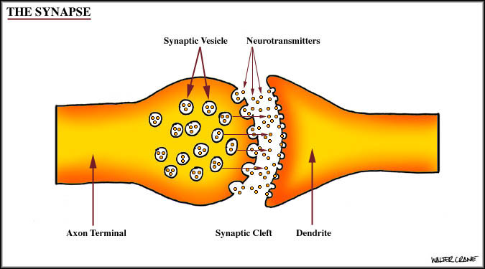
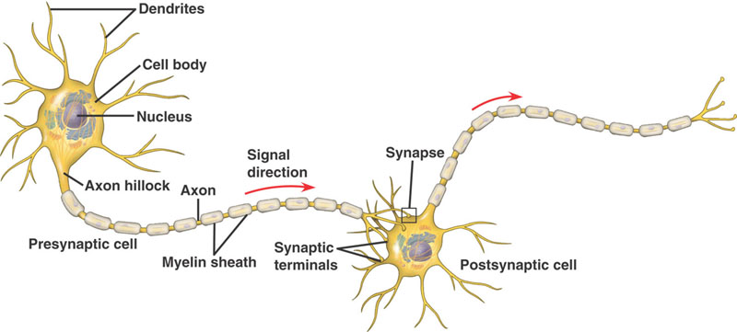
Neurons

Slide 18
Neurotransmitters
There are over 40 neurotransmitters. Here are five:
Acetylcholine – memory, learning
Dopamine – pleasure, reward, euphoria
Enkephalin – pain suppressant
GABA – muscle relaxant, reduces anxiety
Serotonin – sleep control, sensory perception, emotional stability

Slide 19
Drug addiction
a chronic, often relapsing brain disease that causes compulsive drug seeking and use, despite harmful consequences to the addicted individual and to those around him or her
Notes:
Show DVD video clip brain science

Slide 20
Facts about drug use, abuse and addiction
1. Among adults who smoke, 68 percent began smoking regularly at age 18 or younger, and 85 percent started when they were 21 or younger.
2. Every day, almost 3,900 children under 18 years of age try their first cigarette, and more than 950 of them will become new, regular daily smokers. Half of them will ultimately die from their habit.
3. People who begin smoking at an early age are more likely to develop a severe addiction to nicotine than those who start at a later age.
4. Cigarette smoking is the number one cause of preventable disease and death worldwide. Smoking-related diseases claim over 393,000 American lives each year.
5. Cigarette smoking accounts for at least 30% of all cancer deaths.

Slide 21
Facts continued
6. 50% of U.S. teens who start drinking alcohol before
age 14 will be addicted to it at some point.
7. Alcohol-related motor accidents are the second leading cause of teen death in the United States.
8. Did you know that kids who learn a lot about the risks of drugs from their parents are up to 50 percent less likely to use drugs?
9. 2007 National Survey in the USA on Drug Use and Health showed that 8% of the population aged 12 or older used illegal drugs.
10. The most commonly used illegal drug is marijuana.

Slide 22
Drug abuse versus Addiction
Drug abuse:
using an illegal substance or using a legal substance in the wrong way
Drug Addiction:
a chronic, often relapsing brain disease that causes compulsive drug seeking and use, despite harmful consequences to the addicted individual and to those around him or her
What does “compulsive” mean?

Slide 23
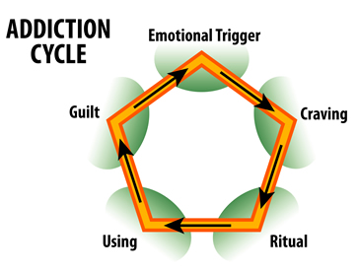
Notes:
What are some examples of an emotional trigger?
Rituals? Special routines that intensify preoccupation of the drug, planning to use, eases internal tension, etc
Show video clip on the Brain and Drugs

Slide 24
Activity
You will be shown a picture on the next slide. You will be given one minute to try and memorize the items shown in the picture.
Notes:
Here is a quick activity that will give you an idea on how addiction can develop.

Slide 25
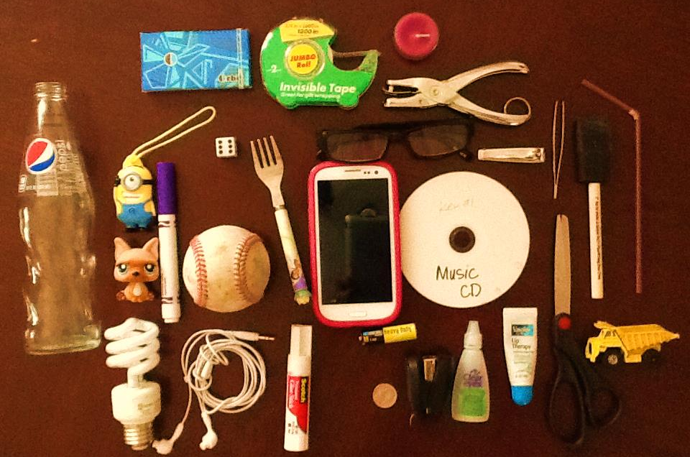

Slide 26
Write down the items you remember
How many items were you able to remember?
Do you think you will be able to remember more if shown the picture again for another minute?
Let’s try it again

Slide 27
Write down the items you remember
Why do you think you were able to recall a few more items after looking at the picture a second time?
Notes:
Some people can recall information accurately after a few times of being exposed to it. Some people require more exposure to that same information to accurately recall. But eventually everyone can get it. It just takes more effort for some of us than others. We have different learning styles, come from different backgrounds, etc.
Does this take effort in trying to memorize the items?
Drugs take no effort. Instant gratification.

Slide 28
Repetition activity and worksheet
Notes:
Allow students about 7-8 minutes to try this activity. Discuss then move on to the brain.

Slide 29
Your Brain At a Glance
Complete the worksheet on the back of your handout
Questions:
Which part of the brain is also known as the “emotional brain”?
Limbic System
Which part of the brain takes care of hearing, seeing, thinking and the sense of touch?
Cerebral cortex
What are neurotransmitters?
brain chemicals (example is dopamine)

Slide 30
Analyzing the Risk and Protective Factors that influence the use, abuse and addiction of drugs
Risk Factors
Protective Factors
Early aggressive behavior
Lack of parental supervision
Academic problems
Undiagnosed mental health problems
Peer substance use
Drug availability
Poverty
Peer rejection
Child abuse or neglect
Positive physical development
High self-esteem
Good coping skills and problem-solving skills
Engagement and connections in two or more of the following contexts: at school, with peers, in athletics, employment, religion, culture
Family provides structure, limits, rules, monitoring, and predictability
Supportive relationships with family members
Clear expectations for behavior and values

Slide 31
