Slide 1
Unhealthy Relationships

Slide 2
What should I look for in a partner?
Treat you with respect.
Doesn’t make fun of things you like or want to do.
Never puts you down.
Doesn’t get angry if you spend time with your friends or family.
Listens to your ideas and compromise sometimes.
Isn't excessively negative.
Shares some of your interests such as movies, sports, reading, dancing or music.
Isn’t afraid to share their thoughts and feelings.
Is comfortable around your friends and family.
Is proud of your accomplishments and successes.
Respects your boundaries and does not abuse technology.
Doesn’t require you to "check in" or need to know where you are all the time.
Is caring and honest.
Doesn’t pressure you to do things that you don’t want to do.
Doesn’t constantly accuse you of cheating or being unfaithful.
Encourages you to do well in school or at work.
Doesn’t threaten you or make you feel scared.
Understands the importance of healthy relationships.

Slide 3
Warning Signs of Abuse
Checking cell phones, emails or social networks without permission
Extreme jealousy or insecurity
Constant belittling or put-downs
Explosive temper
Isolation from family and friends
Making false accusations
Erratic mood swings
Physically inflicting pain or hurt in any way
Possessiveness
Telling someone what to do
Repeatedly pressuring someone to have sex

Slide 4
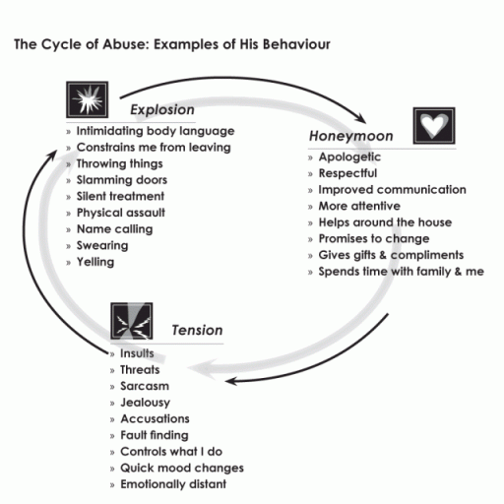

Slide 5
Where to get help
A trusted adult
Counselor
Parent
Statewide Toll-Free InfoLink Hotline: (800) 799-SAFE *National
Utah Domestic Violence Council 205 North 400 West Salt Lake City, UT 84103 Phone: (801) 521-5548 Web: http://www.udvac.org
Notes:
Video break up violence
https://www.youtube.com/watch?v=xIbQ1f4i1fQ&list=PLcFHkKbd_jTKDmkz1uC83IKpSiXHlrN_d&index=5
http://www.youtube.com/watch?v=rZLmBVG0QDM&list=PLcFHkKbd_jTKDmkz1uC83IKpSiXHlrN_d&index=7

Slide 6
Unhealthy Peer Relationships
1. The people pleaser-continuously seeks approval of others
2. The enabler- supports others harmful behaviors
3. The clinger- needy and dependent
4. The fixer- tries to fix other peoples problems
5. The distancer- emotionally unavailable to others
6. The controller- possessive, jealous, and domineering
7. The center- is self-centered
8. The abuser- a person who is abusive
9. The liar- does no tell the truth
10. The promise breaker- is not reliable

Slide 7
Group Activity: Unhealthy Peer Relationship Conversation
Each group will be assigned one of the unhealthy peer relationships. Do not tell another group which one you have been assigned.
First, each group will describe the scenario where this conversation is taking place
Second, each group will create a conversation script between two friends that demonstrates the unhealthy peer relationship you have been assigned. (Minimum 10 statements)
Finally, your group will present your conversation to the class and at the end of your presentation the class will guess the unhealthy peer relationship your group is demonstrating.

